Slide 1


Titolo presentazione sottotitolo
Assessing Component Degradation using Sparse Autoencoders Optimized by a Coevolutionary Framework
Milano, XX mese 20XX
- A Review of the Framework
- Aramis Challenge Case Study

Slide 2
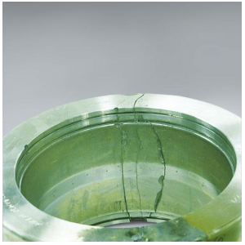
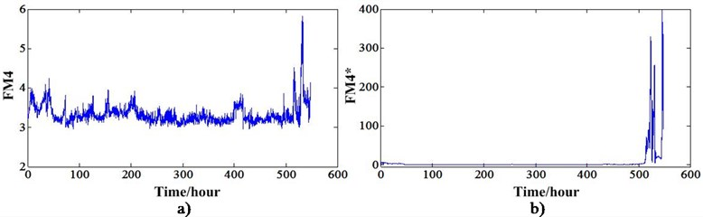
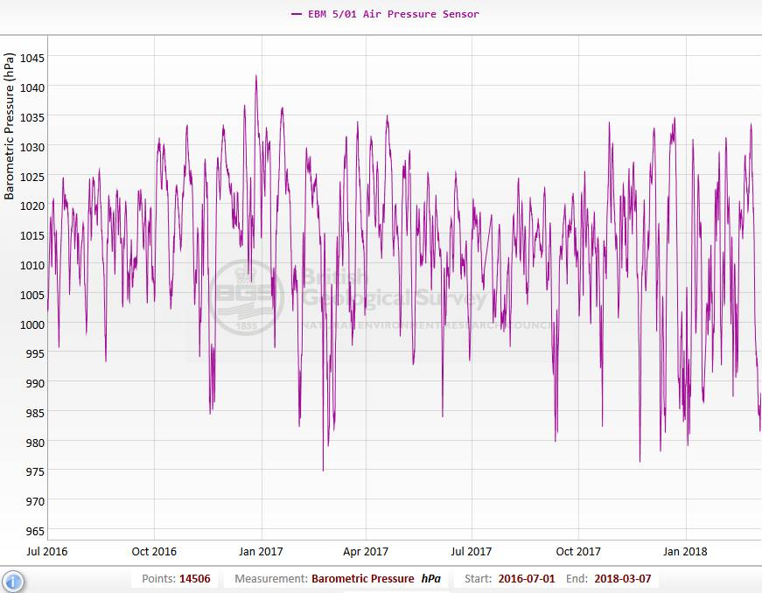
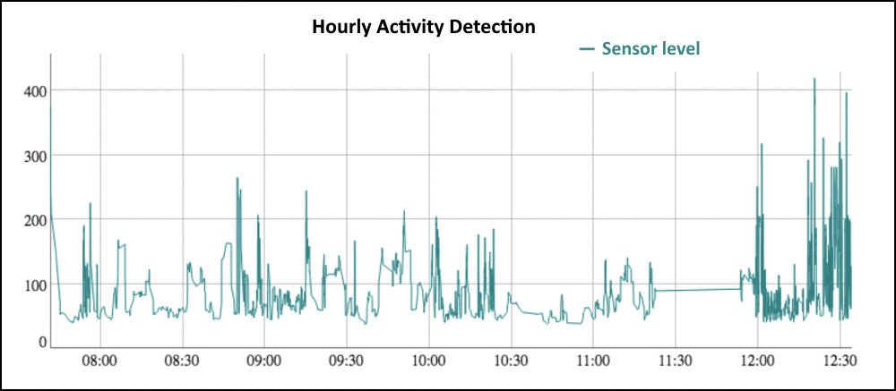
What is the problem?
P
Degradation Assessment Module
Degraded
T
Vibration
Healthy
Advantages:
Reduced downtime
Reduced unplanned failures
Reduced overall maintenance costs
…
Condition-Based Maintenance
Notes:
We are looking for a degradation assessment module which receives sensor signals from an operating component and tells us the health condition of the component. Such a module is essential for condition-based maintenance, since it provides the opportunity to plan maintenance sessions accordingly, reducing the downtime, unplanned failures, costs, and so on.

Slide 3

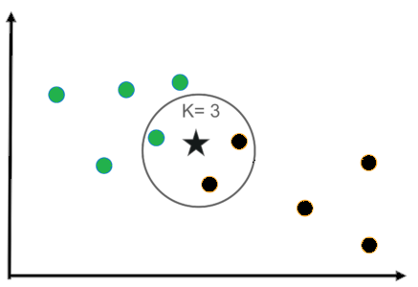
Possible solutions: Traditional methods
Hand-crafted feature design
Principle Component Analysis
(PCA)
Signal processing
Wavelet
Statistical analysis
…
---------------------------------------------------------
Supervised machine learning
K-Nearest Neighbours classifiers
(KNN)
Support Vector
Machines
…
Only for linear problems
Require expert knowledge
PCA
Degraded
P
T
Healthy
KNN
Healthy
Ambiguous
Degraded
Labeled data unavailable
Notes:
Traditional methods for this problem include hand-crafted feature design, which utilize PCA and Signal Processing methods, and supervised machine learning. However, PCA can only be used for linear problems, signal processing-based methods require expert knowledge, and supervised machine learning methods need labelled data, which are usually unavailable, or inadequate.

Slide 4
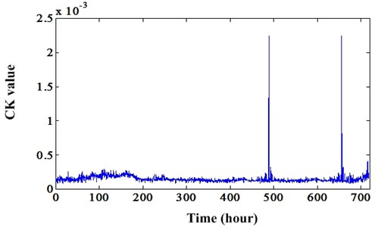
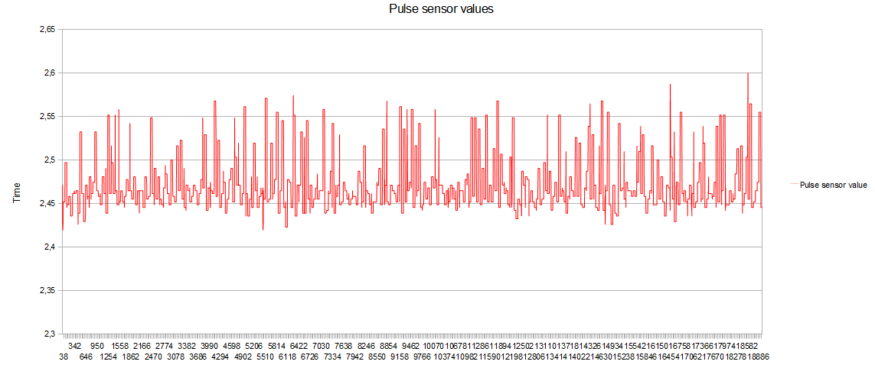
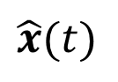
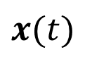
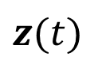
Investigated solution
Sparse Autoencoder (SAE):
$$z(t)$$
Reconstructed signals
$$x(t)$$
Signals
$$\hat{x}(t)$$
Encoder
Decoder
Latent representation of 𝑥(𝑡)
→ Information on degradation, operating conditions, process noise, etc.
Notes:
So, we concentrate on unsupervised machine learning, and investigate sparse autoencoders. By training a sparse autoencoder, we can obtain a condensed latent representation of the input signals, which in our case contain information about degradation, operating conditions, process noise and so on. We are aiming at extracting the information related to the degradation process.

Slide 5
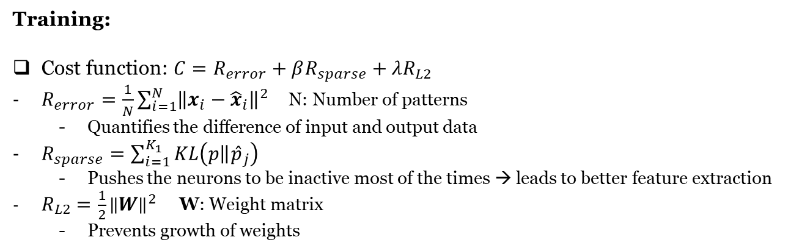
Investigated solution
Sparse Autoencoder (SAE):
$$z(t)$$
Reconstructed signals
$$x(t)$$
Signals
$$\hat{x}(t)$$
Training:
Cost function: $C=R_{error}+βR_{sparse}+λR_{L2}$
$R_{error}=\frac{1}{N}\sum_{i=1}^{N}{{\left\|x_{i}−{\hat{x}}_{i}\right\|}^{2}}$ N: Number of patterns
Quantifies the difference of input and output data
$R_{sparse}=\sum_{i=1}^{K_{1}}{KL\left(\left.p\right\|{\hat{p}}_{j}\right)}$
Pushes the neurons to be inactive most of the times → leads to better feature extraction
$R_{L2}=\frac{1}{2}{\left\|W\right\|}^{2}$ W: Weight matrix
Prevents growth of weights
Encoder
Decoder
Notes:
The cost function for training a sparse autoencoder contains three terms.

Slide 6
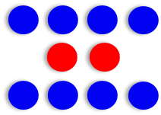
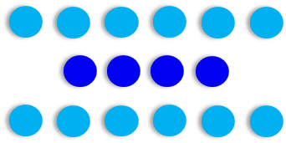
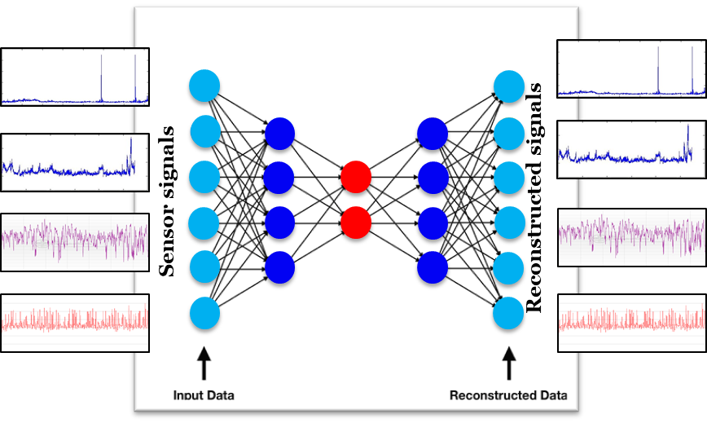
Investigated solution
Deep Autoencoder:
First layer (AE 1)
Second layer (AE 2)
Fine-tuning
Notes:
Deep autoencoders are usually used for a more effective feature extraction. Their training process includes a greedy layer-wise pre-training, in which each hidden layer is pre-trained by the activations of the previous layer as input and output, and fine-tuning, in which the hidden layers are stacked together to build the encoder, and then a symmetrical decoder is added on top to build the deep autoencoder, which is then fine-tuned.

Slide 7
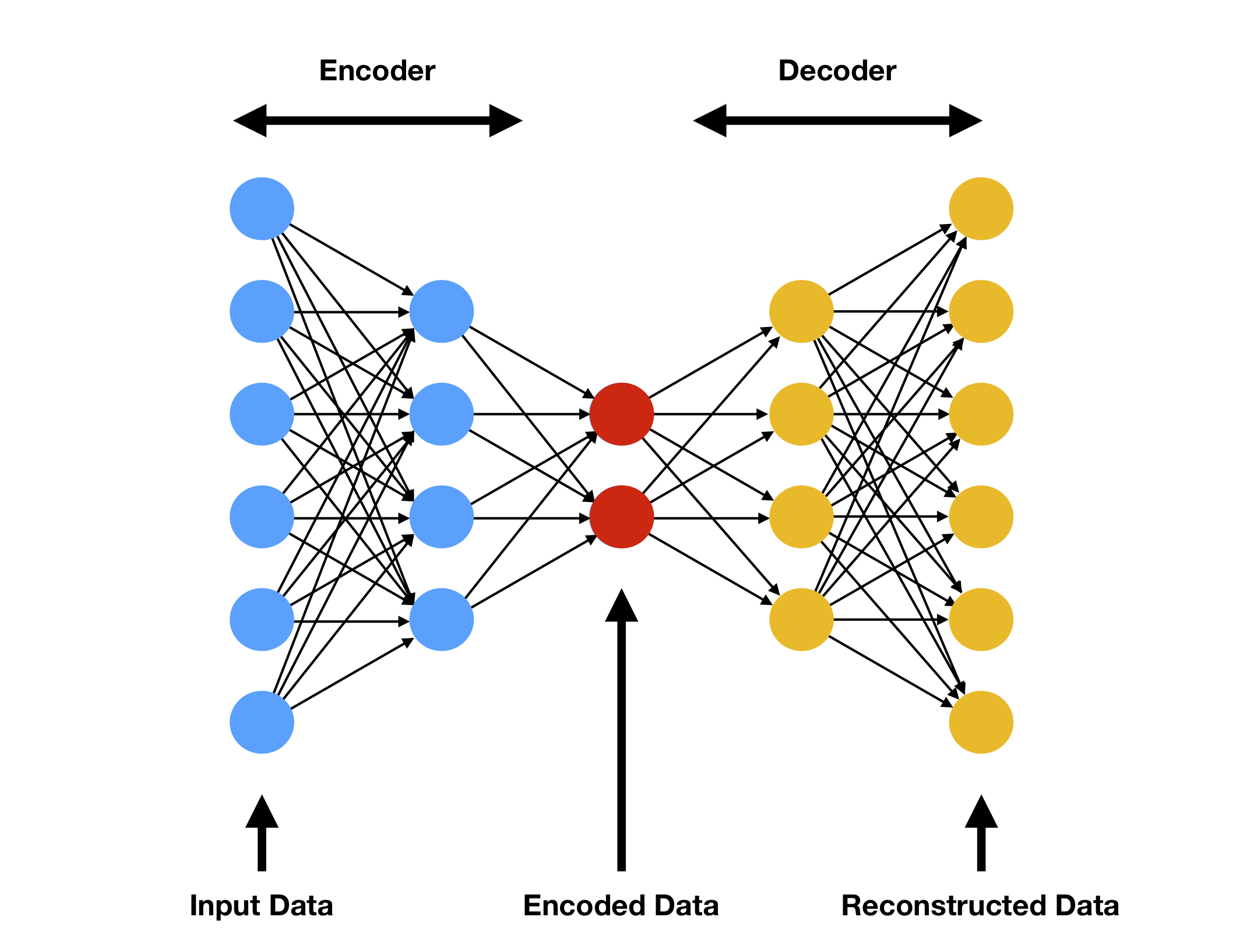
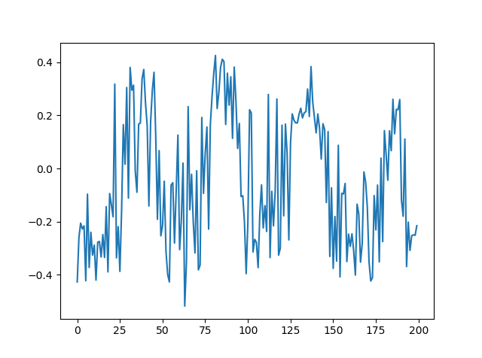
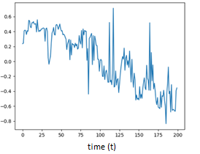
Investigated Solution
Deep Autoencoder:
Sensor signals
Encoded data
Perform Mann-Kendall monotonicity test
Select the most monotonic feature
Which feature is the degradation indicator?
The most monotonic one!
Degradation indicator
Notes:
After training the deep sparse autoencoder, the decoder can be deleted and the encoder can be used for extracting the latent features. But, how to know which feature is representing the degradation process? As we know, degradation is a monotonic process. Therefore, an effective method is performing a monotonicity test on the extracted features, like Mann-Kendal test which we have used here, to select the most monotonic feature, since it will have the largest correlation with the latent degradation factor of the input data, and can be used as a degradation indicator.

Slide 8
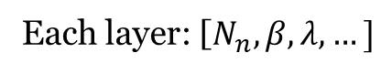
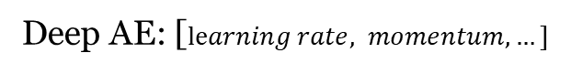
Problem: Architecture and Hyperparameters Setting Possible solutions
Each layer: [$N_{n}, β, λ, …]$
Deep AE: [$learning rate, momentum, …]$
Search space too big
Trial and error
Exhaustive search
Genetic Algorithm
Trapped in local optima
Population
Evolution
Selection
Evaluation
Notes:
However, we have a problem, which is tuning the architecture and hyperparameter setting of the sparse autoencoder. We have numerous hyperparameters, some of them related to specific layers and some of them related to the network as a whole. Especially, setting the hyperparameters related to the sparsity Regularizer is vital for obtaining a network that can output features that contain signals with high monotonicity. Trial and error and exhaustive search are not feasible, since the search space is huge. Therefor, an effective search algorithm is required. Genetic algorithms are a candidate, but are frequently trapped in local optima, because they are unable to preserve diversity in the population in an effective way.

Slide 9
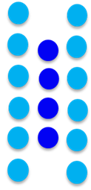
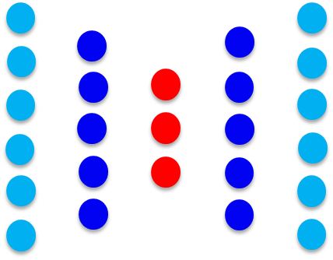
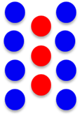
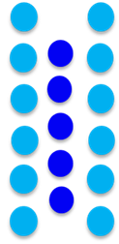
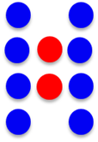
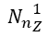
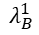
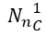
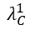
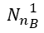
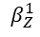
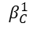
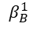
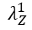
Proposed method: A Cooperative Coevolutionary Approach
Layer Population
Network Population
Layer 1 species
Layer 2 species
…
$${N_{n}}_{B}^{1}$$
$$β_{B}^{1}$$
$$λ_{B}^{1}$$
…
$${N_{n}}_{C}^{1}$$
$$β_{C}^{1}$$
$$λ_{C}^{1}$$
…
…
$${N_{n}}_{Z}^{1}$$
$$β_{Z}^{1}$$
$$λ_{Z}^{1}$$
…
…
Subpopulations
Notes:
Therefore, we propose a cooperative coevolutionary algorithm. This algorithm includes two populations. One layer population, which includes one species for each layer of the deep autoencoder and each layer species contains individuals representing the hyperparameters related to that layer, and one network population, in which each individual represents one deep autoencoder. Each individual’s chromosome in the network population has two parts. The first part contains the genes related to the network-specific hyperparameters, and the second part contains genes representing indexes for one layer from each layer species.

Slide 10
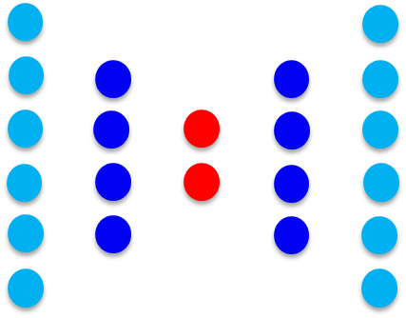
Proposed method: A Cooperative Coevolutionary Approach
Algorithm scheme:
Layer 1 individuals
Network individuals
Layer 2 individuals
…
…
Monotonicity: 13.2
Loss: 2.1
Initialization
Monotonicity: 15.2
Loss: 0.1
Networks evolution
Layers evolution
Final population
Yes
No
Max generations?
Layers credit assignment
Networks evaluation
Network objectives:
Monotonicity to Maximize
Validation loss of training to minimize
Layer objective:
Rank of the best network containing that layer
Notes:
The algorithm scheme is as you see here. Network individuals have two objectives: The monotonicity of the most monotonic feature extracted by that network to maximize, and the validation loss of the training to minimize. Including the validation loss as an objective for network individuals was necessary, because it was observed that it is possible to obtain a monotonic feature without properly training the autoencoder, which obviously the feature will not truly represent the degradation feature. Therefore, we have a multi-objective evolution in the network population. The layer individuals on the other hand have one objective function, which is the rank of the nest autoencoder which contains that layer. The cooperative coevolutionary algorithm is run for a max number of generations, and one autoencoder is selected as the best one with the capacity to produce a highly monotonic latent feature.

Slide 11
Case study: Aramis Dataset
The dataset is made up of a train set with 200 4-component systems (800 trajectories) and a test set with 50 4-component systems (200 trajectories).
411 trajectories in the train set contain elbow points, i.e. enter abnormal state.
The min, max, and average time of entering the abnormal state are: 800, 998, 918.
The min, max, and average mission time of the trajectories are: 896, 1000, 996
The dataset is imbalanced
over-sampling

Slide 12
Method:
Only the trajectories from the train set with elbow point are considered for training.
The train set is divided into train and validation sets (3:1)
The best AE obtained from the CoEA (which is already trained on one trajectory in the CoEA) is selected and trained on the whole train set. After 4 epochs, the MSE gets lower than 1e-5 and the training is stopped by early stopping.
The classifier is built by removing the decoder and adding a classification layer with two neurons for the two classes (0 and 1) on top of the encoder.
The selected loss function for the classifier is Binary Cross Entropy and the classification layer activation function is Sigmoid. “Nadam” optimizer is used for training.
First, the encoder weights are frozen and the classifier is trained for 100 epochs. Then, the final layer weights of the encoder are un-frozen and the classifier is trained for 200 more epochs. Finally, the penultimate layer of the encoder is un-frozen and the training goes on.

Slide 13
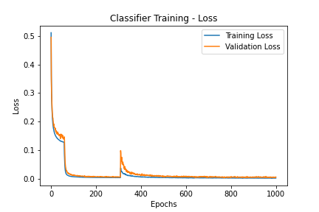
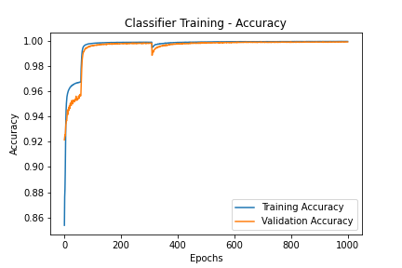
Results
The minority class (“1”s) is oversampled using SMOTE method.
Aramis metric for the validation set reached a minimum value of 0.0629 at epoch 984.

Slide 14
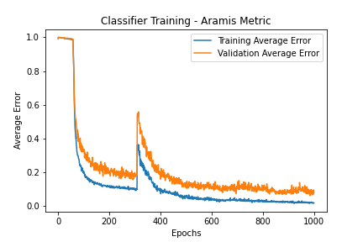
Results
The resulting value for Aramis metric for the test set is 0.0735

